Slide 1
S4ND: Single-Shot Single-Scale Lung Nodule Detection
陈浩宇
2020.04.23

Slide 2
Contributions
A completely 3D deep network architecture designed to detect lung nodules in a single shot using a single-scale network, without the need for additional FP removal and user guidance for refinement of detection process
First study to perform lung nodule detection in one step.
We also critically analyzed the role of densely connected layers as well as max pooling, average pooling and fully convolutional down sampling in detection process.

Slide 3
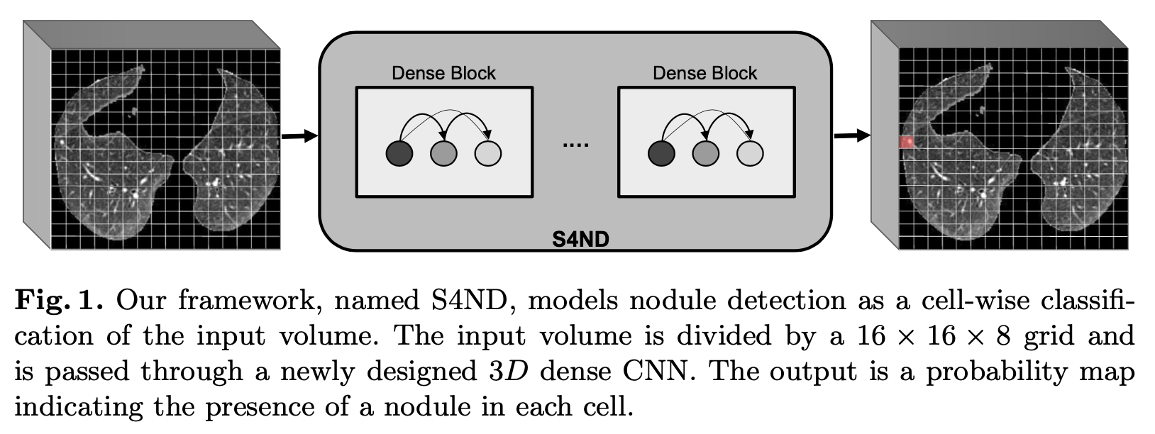
Method
3D densely CNN
Divides the input volume into a grid of size S × S × T (16 ×16 ×8) cells
Model lung nodule detection as a cell-wise classification problem

Slide 4
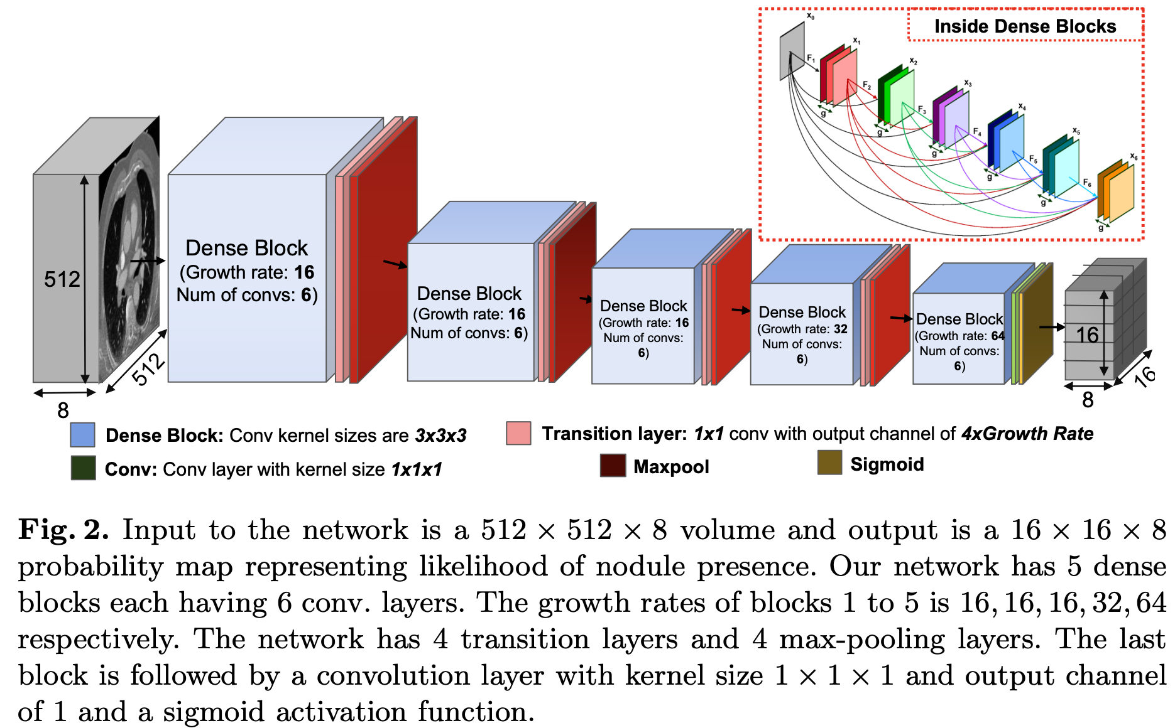
3D Deep Network Architecture

Slide 5
Experiments and Results
Dataset: LUNA16
Comparisons:
improved SSD
average pooling
convolution layers with kernel size 3 × 3 and stride 2
max pooling
3D DCNN

Slide 6
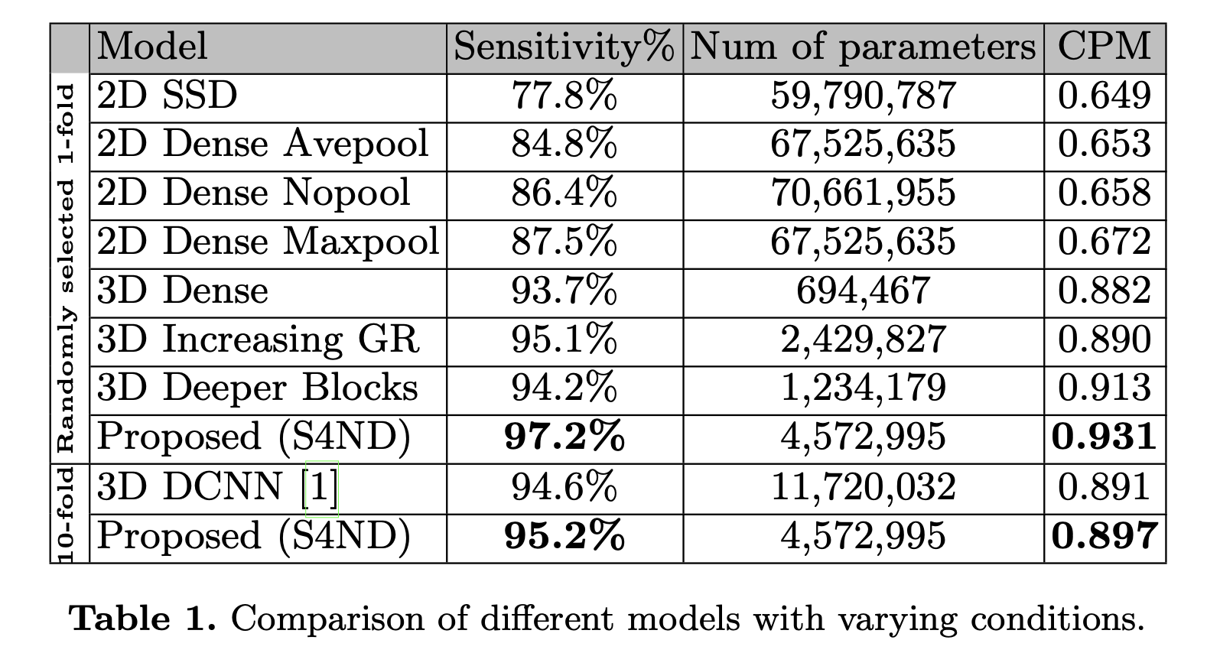
Experiments and Results

Slide 7
Conclusion
Single-shot single-scale fast lung nodule detection al- gorithm without the need for additional FP removal and user guidance.
3D densely CNN.
Model lung nodule detection as a cell-wise classification problem.
Max pooling is best, convolution with stride 2 outperforms the average pooling.

